Slide 1

Project Update
5 Sept, 2023

Slide 2
Data Models
The information retrieval model needs to provide the framework for the system to work and define the many aspects of the retrieval procedure of the retrieval engines
The IR model has to provide a system for how the documents in the collection and user’s queries are transformed.
The classical IR systems are designed based on mathematical concepts and are the most widely used, simplest, and easy-to-implement systems for information retrieval models.

Slide 3
Boolean Retrieval Model
The Boolean model in information retrieval is based on the set theory and boolean algebra. We can pose any query in the form of a Boolean expression of terms where the terms are logically combined using the Boolean operators AND, OR, and NOT in the Boolean retrieval model.
The queries are designed as boolean expressions which have precise semantics and the retrieval strategy is based on binary decision criterion.
The Boolean model can also be explained well by mapping the terms in the query with a set of documents.

Slide 4
Key factors
Indexing
Term-Document Incidence matrix
Stemming
Domain-specific dictionary

Slide 5
Pros and Cons
computationally efficient
great expressive power and clarity
difficult to construct effective Boolean queries
users will make errors when they form a Boolean query

Slide 6
Vector Space Model
The vector space model represents the documents and queries as vectors in a multidimensional space whose dimensions are the terms further used to build an index to represent the documents.
based on the notion of similarity between the search document and the representative query prepared by the user
We can represent both documents and queries with vectors with a t-dimensional vector representation:
dj = (w1,j,w2,j,...,wt,j) for a document with
q = (w1,q,w2,q,...,wt,q)

Slide 7
Imp terms
Angle of deviation between query and document
Cosine distance as similarity metric
Ranking the results using a similarity metric
Lexical scanning

Slide 8
Pros and Cons
Long documents are poorly represented
precisely designed to match document terms
false negative matches
problematic in case of incremental updates of the index

Slide 9
Study type prediction & Intervention prediction
Disease prediction was already done.
We needed to make predictions for study type and intervention fields as well, which has been done.
(Files in folder).

Slide 10
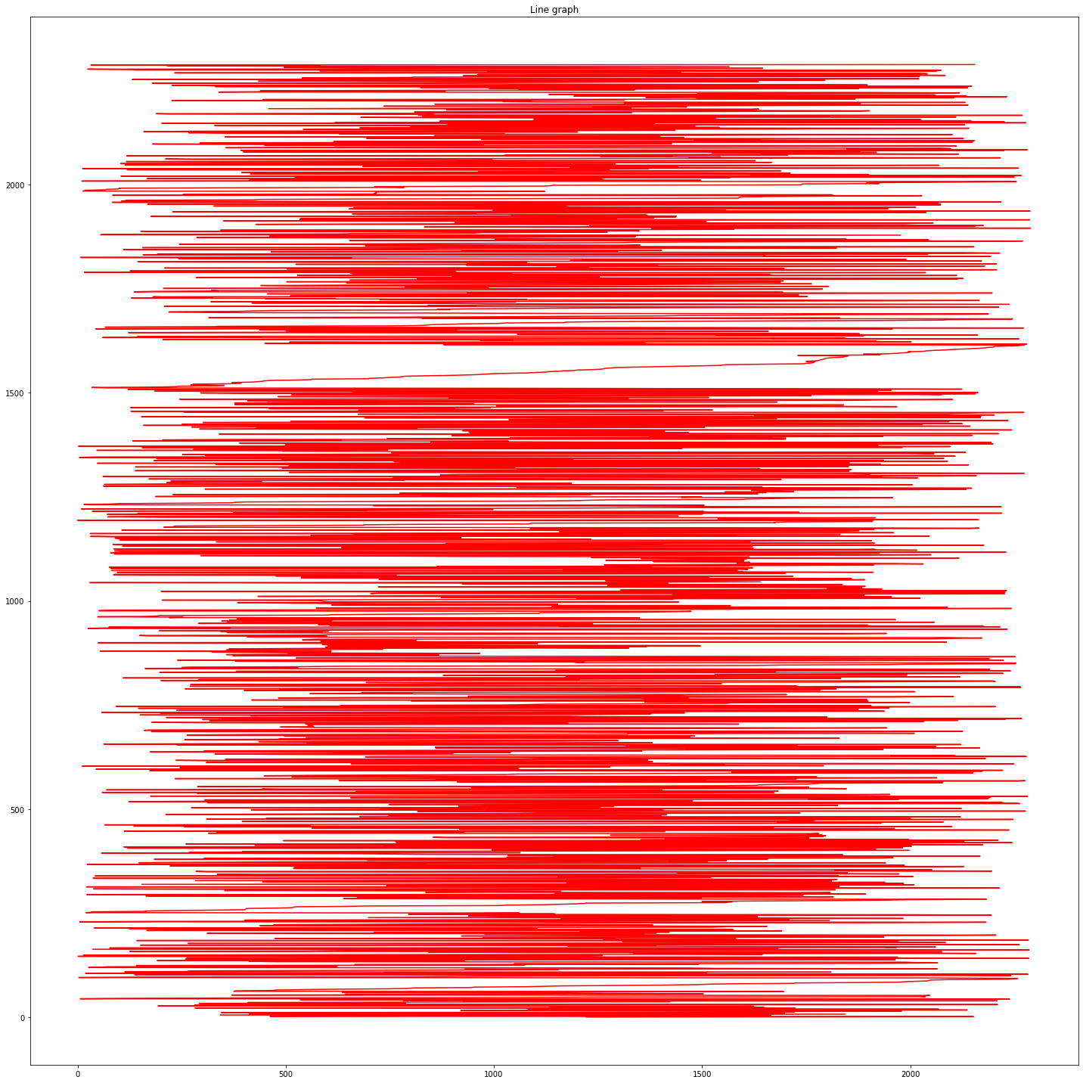
Data Description in terms of Label Distribution

Slide 11
Thank you

